Slide 1
Surface Area to Volume Ratio
SA/V

Slide 2
Surface area to volume ratio
The greater the sa/v ratio of a cell, the faster materials can diffuse through to every part of it
A 1cm³ cube has a 6:1 sa/v ratio
A cube with sides of 2cm has a 3:1 sa/v ratio. It will take twice as long for O₂ to reach its centre

Slide 3
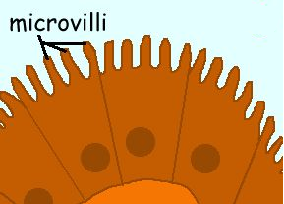
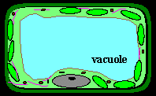
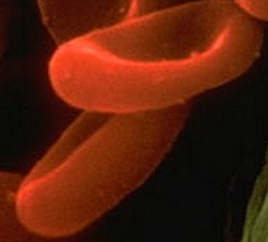
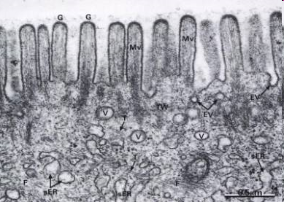
Surface area to volume ratio (cont’d)
Ways to avoid the sa/v ratio problem:
Have small cells
Have a water filled vacuole in the middle
Have flat cells
Have microvilli

